Slide 1


Access to Work 2024
1
Add a footer

Slide 2

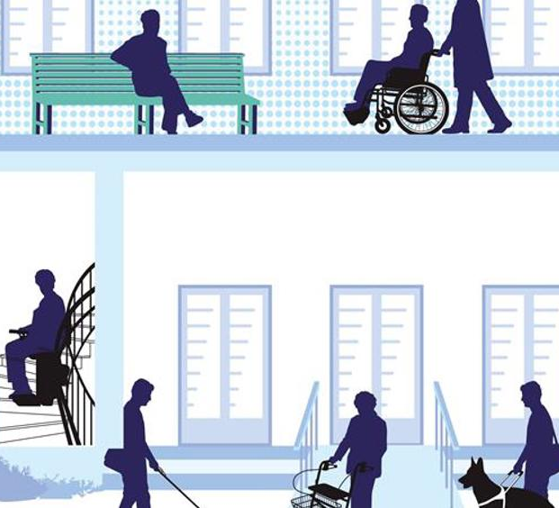
Objectives
Access to Work
What can it pay for
How to access it
Who is eligible
The Health Adjustment Passport
Further Support

Slide 3

Access to Work
A government grant that provides tailored support and advice to help overcome individual barriers to work.
If you have a disability or health condition and are in or about to start work you may be eligible.
Access to Work provides practical support to people with all types of health conditions & disabilities, including mental health, which does not have to be diagnosed.
Advisors can advocate on your behalf to make sure things are put in place to enable you to access employment and function in your role. These are known as Reasonable Adjustments.
.

Slide 4

What could Access to Work pay for?
Examples of Reasonable Adjustments:
Special equipment or adaptations.
A support worker in the workplace.
Communication support at a job interview or workplace.
Travel support to work.
Mental Health Support Services for people who are experiencing difficulties with their wellbeing at work.

Slide 5

Access to Work can help with financial contributions towards making changes or adaptions to workplace equipment.
This could include:
Adjusting a desk, computer, chair or transferring equipment to another post or job role.
Help towards making accessibility changes to a vehicle needed for transportation to work.
In some cases, it could pay towards taxi fares. This could be for interviews or job trials, if you are unable to use public transport.

Slide 6
Access to work could also provide interpreter services.
This includes:
British Sign Language
Lip speakers or note takers.
It can also provide an Advisor to help you sustain your job.
This could be advice or support with advocating, onsite counselling, mentoring or job coaching if required.

Slide 7
How to apply
You can apply for Access to Work directly online.
You can request direct assistance from an Access to Work advisor, if they need help to complete the online form.
The following web page provides further
information on requirements
and how to apply.
www.gov.uk/access-to-work/apply

Slide 8
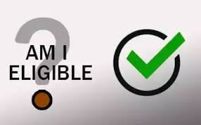
Who can apply for Access to Work?
You need to have a disability or health condition that affects your ability to work.
Need to pay work-related costs e.g., specialist equipment or additional travel costs.
Are returning to work, in work or about to start paid work.
Work Type eligibility:
One of the following must apply:
Have a paid job
Be self-employed
Have a confirmed job interview
About to start a job or work trial
Starting work experience.

Slide 9

Access to Work – Eligibility Continued
Exceptions
You might not get Access to Work support if you get any of the following benefits:
Incapacity Benefit.
Employment and Support Allowance (ESA).
Severe Disablement Allowance.
Income Support.

Slide 10
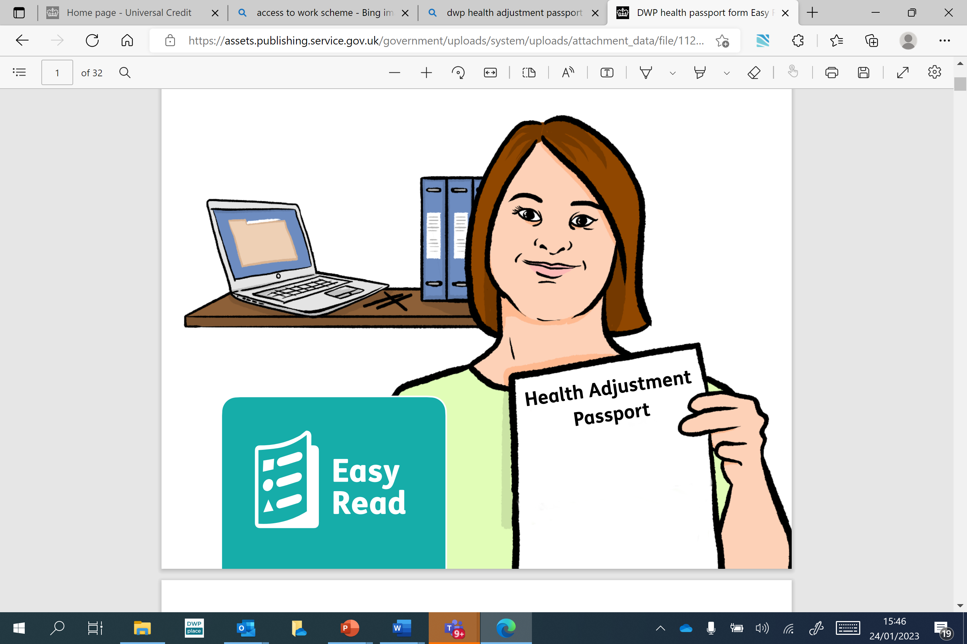
What is the Access to Work Health Adjustment Passport?
The Health Adjustment Passport provides a personalised live documentation of your in-work support needs and adjustments.
It identifies what extra support is needed due to a health condition. It can be used in the workplace or Jobcentre Plus.
It can help with a smooth transition into employment and when changing job roles.

Slide 11
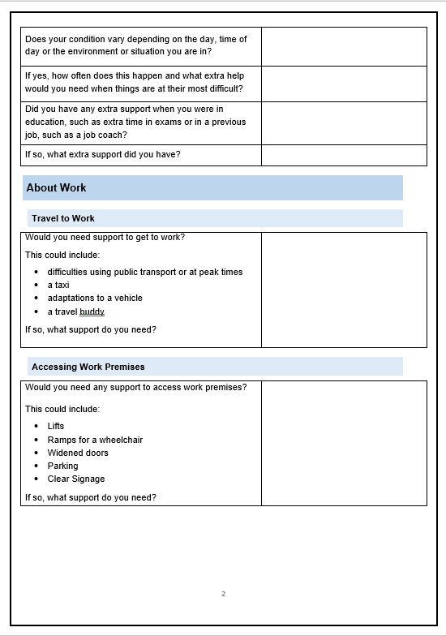
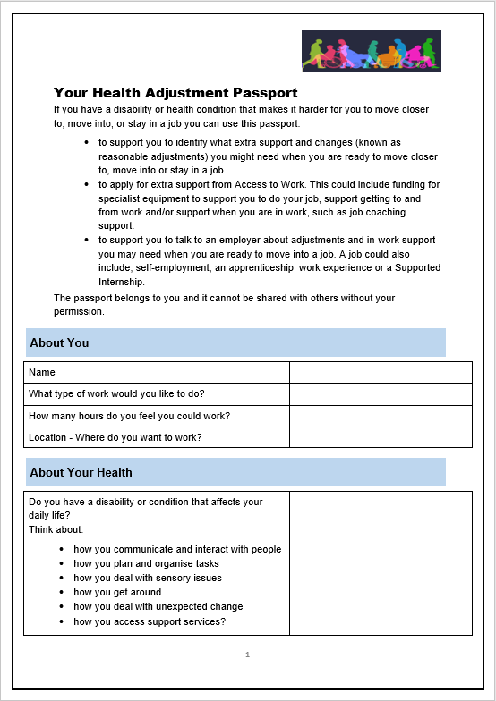
The Health Adjustment Passport - supports you at the Jobcentre
It reduces the need for repeated assessments, where your needs remain the same.
Provides a clear communication tool to support open conversations.
Establishes any need for reasonable adjustments.
Enables adjustments to be put in place quicker.
Assists in job matching by enabling work coaches to select suitable vacancies.
Can be used for self-employment, apprenticeships, work experience or a supported internship.

Slide 12

The Health Adjustment Passport helps employers to support you
Provides an overview of your in-work support
Promotes disability confident & open discussions about workplace reasonable adjustments.
Enables employers to think about tailoring job roles and how these could be adapted to meet individual needs.
Raises awareness of support available for employees via Access to Work.
Access to Work: get support if you have a disability or health condition: What Access to Work is - GOV.UK (www.gov.uk)

Slide 13
Disability discrimination
The Equality Act
The Equality Act 2010 law protects you from discrimination. It also gives you the right to challenge discrimination.
You're protected by the Equality Act if you have a disability. Mental health is also considered a disability.
The Equality Act protects you from discrimination when you:
Apply for work, when you're in a job, and when you leave it.
Access and use services such as hospitals, leisure centres, buses and trains.
It covers jobs and services provided by private companies and services provided by government, local councils and charities

Slide 14
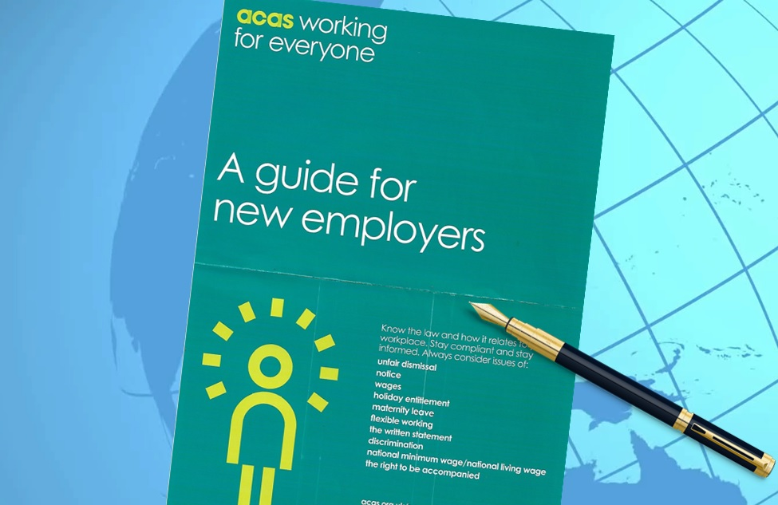
Further Support Available
ACAS: Advisory, Conciliation and Arbitration Service.
They work with millions of employers and employees every year to improve workplace relationships.
They are an independent public body that receives funding from the government.
ACAS gives employees and employers free, impartial advice on workplace rights, rules and best practice. They also help to resolve disputes.
Acas | Making working life better for everyone in Britain

