Slide 1


Slide 2
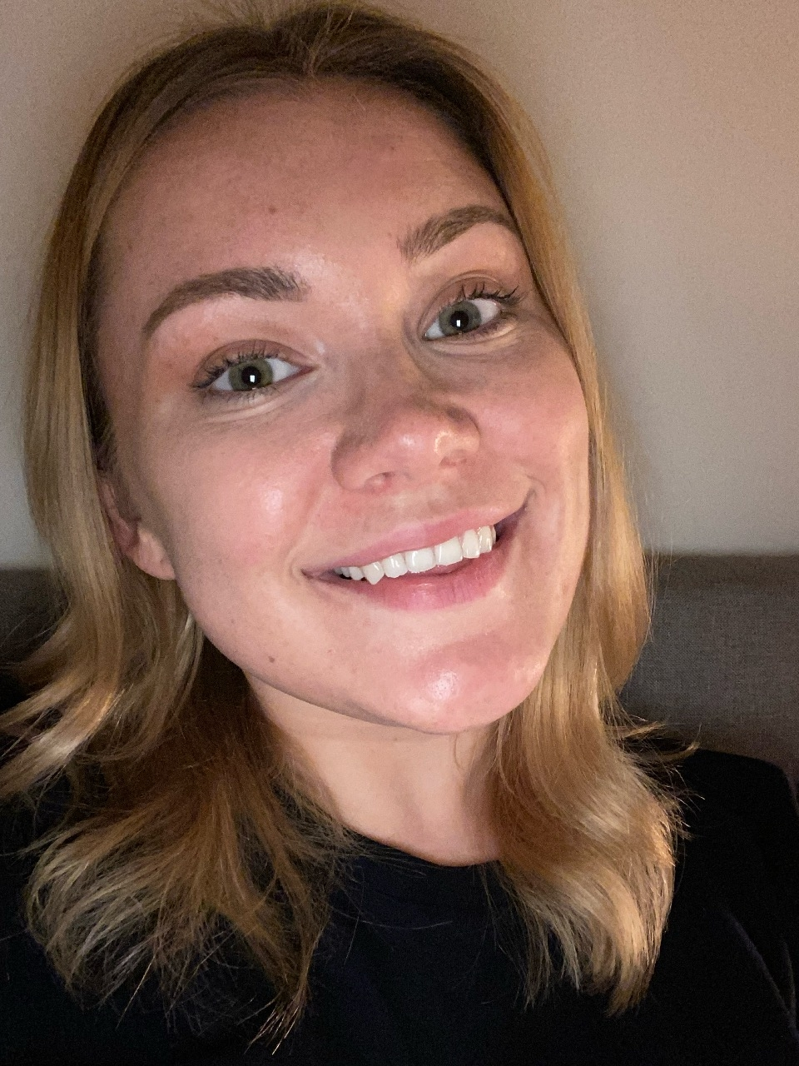
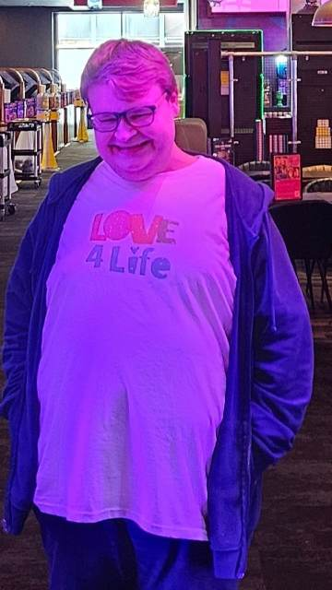
Introductions
Lauren
Coordinator of Hampshire
Bradley
Love4Life member
Chloe
Love4Life member

Slide 3
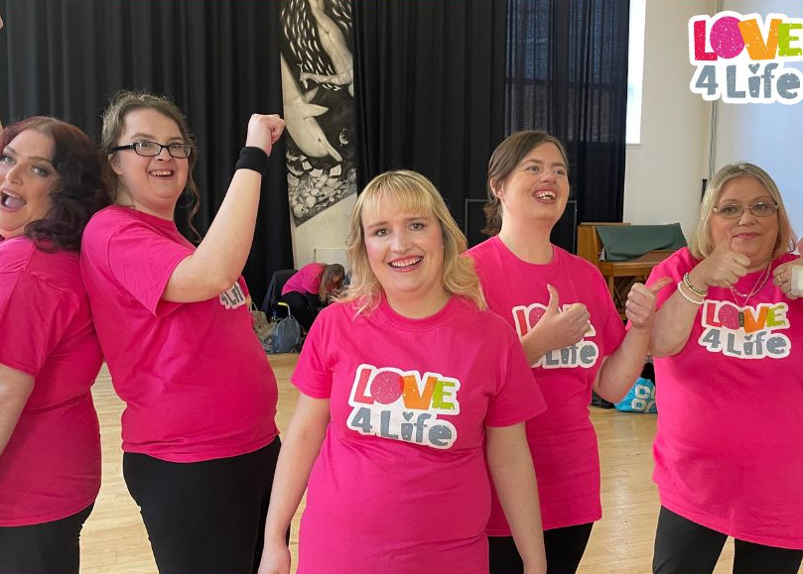
What is Love4Life?
Love4Life is a fully fundraised friendship and dating network for adults (18+) with learning disabilities and autism
Love4Life:
Reduces loneliness and isolation by providing access to up to 25 social events a month in the community
Provides life skills workshops to support independence
Provides a chaperone for dating
Gives one to one guidance on a range of topics including CV writing, contacting a GP and filling out forms
Supports emotional and physical wellbeing
Provides a support network for people with little to no paid support

Slide 4
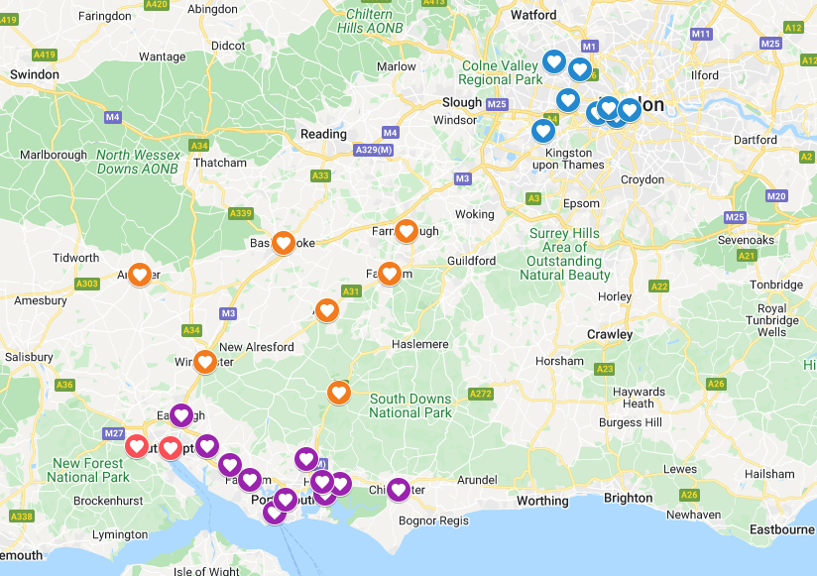
Where does Love4Life operate?
South Hampshire
North Hampshire
Southampton City
London
Coventry
NEW: Online membership for
anyone across the UK

Slide 5
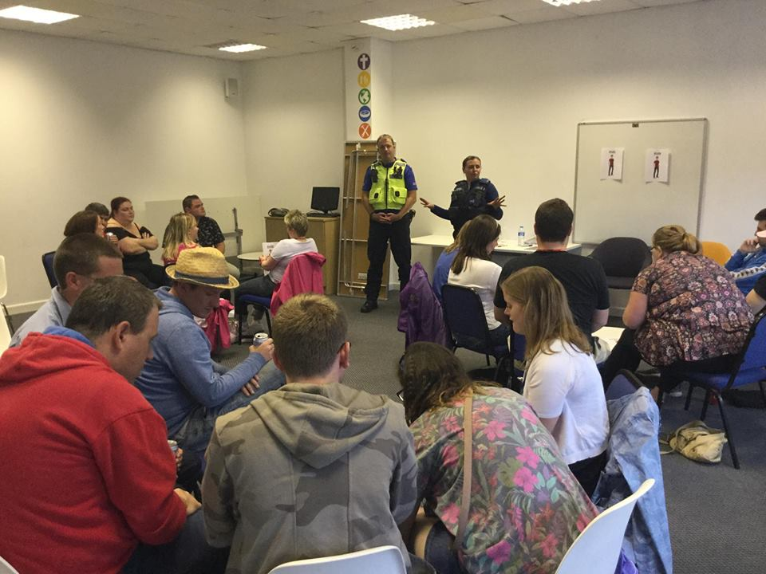
Events include:
Discos, karaoke, meals out, cinema, quiz nights, movie nights, theatre trips, sports activities, festivals and much more
Workshops include:
Cooking lessons, sex education, money management, what is a good friend, what is a good relationship, social media safety, staying safe in my home, first aid and more
All events and workshops are predominantly run in the evening however, some events take place in the daytime
Current membership numbers:
Overall current membership is 285 in person

Slide 6
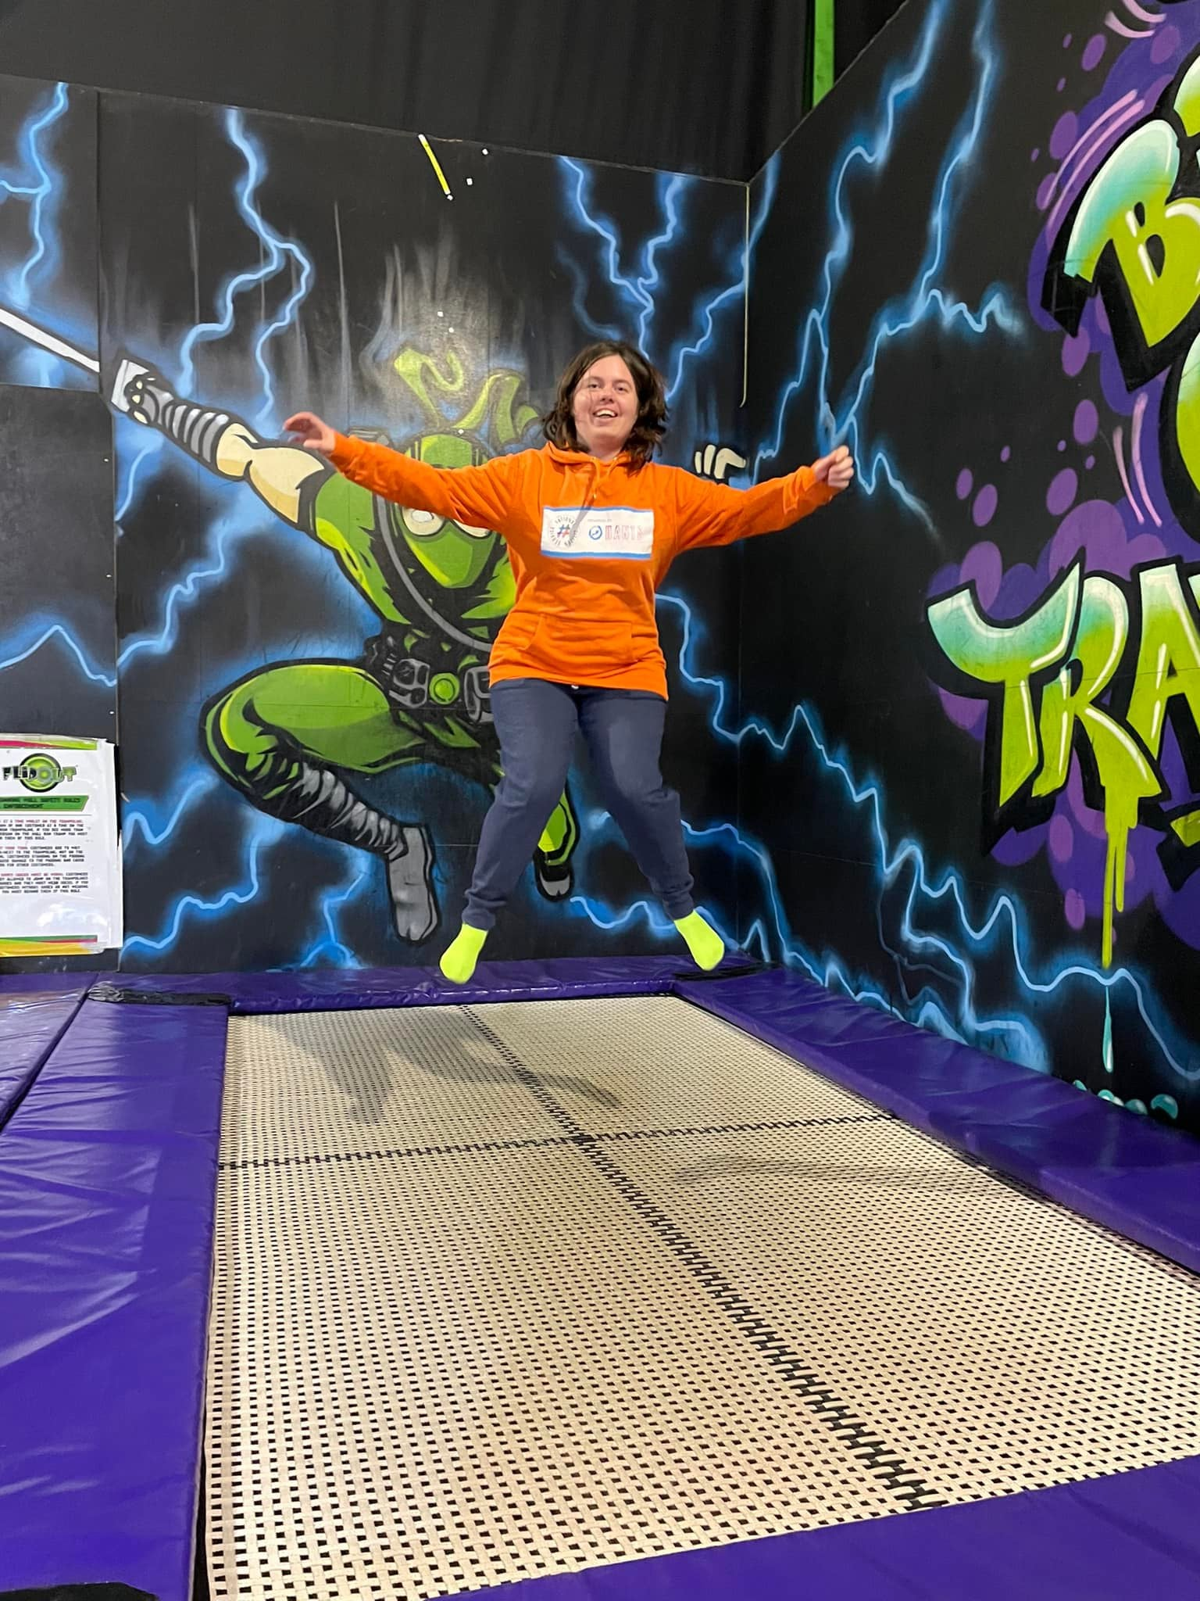
What are the requirements?
We ask all applicants to be over the age of 18
Have a learning disability or autism
Applicants can come independently to events or with support (as per requirement)
How do I apply?
Applicants can apply on our website www.fitzroy.org/love4life
Applicants can also be referred by professionals / parents / carers
They will be asked to provide a reference request
Interview

Slide 7
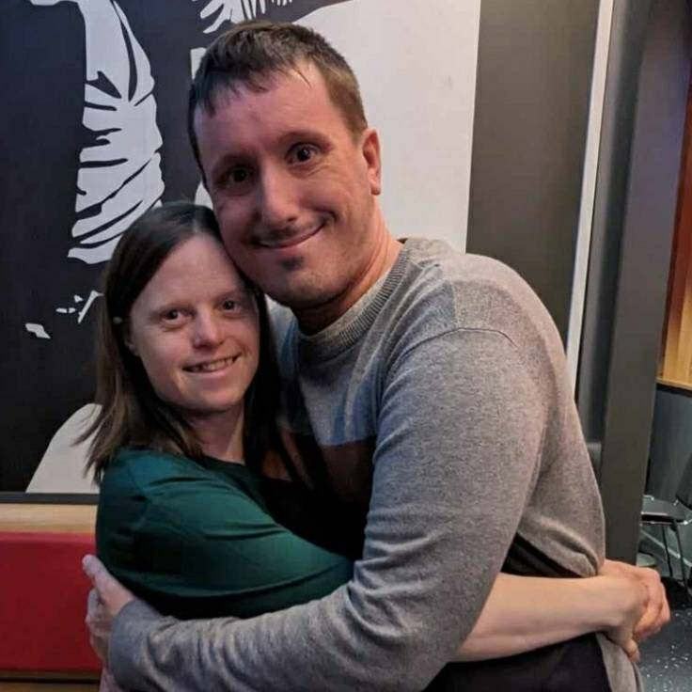
What’s in the future?
Love4Life will be providing external training by people with lived experience (our members) in the following topics:
Oliver McGowen training (mandatory for all social care)
First Aid training
Sex and Relationships
Would your charity benefit from this this training? Please get in touch with our Love4Life manager:
hayley.ostler@love4life.org.uk

Slide 8

…and another thing!
Look out for our public events posted on our social media channels across Hampshire, London and Coventry – open to ANYONE with a learning disability!

Slide 9
What do our members have to say about Love4Life?

Slide 10
What do you know?

Slide 11
Keen to know more? Please provide your name and email on the sheet provided to keep up to date with news about Love4Life
Thank you

